Slide 1

.NET Core: Developing Cross-Platform Web Apps with ASP.NET Core – WorkshopPLUS
< Engineer Name >
Premier Field Engineer
v3.1

Slide 2
For more information, see Use of Microsoft Copyrighted Content at
http://www.microsoft.com/en-us/legal/intellectualproperty/Permissions/default.aspx
Internet Explorer, Microsoft, Microsoft Corporate Logo, SQL Server, and Windows are either registered trademarks or trademarks of Microsoft Corporation in the United States and/or other countries. Other Microsoft products mentioned herein may be either registered trademarks or trademarks of Microsoft Corporation in the United States and/or other countries. All other trademarks are property of their respective owners.

Slide 3
How to View This Presentation
To switch to Notes Page view:
On the ribbon, click the View tab, and then click Notes Page
To navigate through notes, use the Page Up and Page Down keys
Zoom in or zoom out, if required
In the Notes Page view, you can:
Read any supporting text
Terminology List—a list of terms used in this course is provided in the Notes section.
Add notes to your copy of the presentation, if required
Take the presentation files home with you
Notes:
Terminology List

Slide 4
Module 7: Validation
Module Overview

Slide 5
Module 7: Validation
Section 1: Validation Fundamentals
Lesson: Overview

Slide 6
What is Validation?
Notes:
Speaker Notes
Ask this question and collect the responses.

Slide 7
Validation
Validating user inputs and enforcing business rules/logic is a core requirement of most web applications
Server-side validation
Should be done with or without client-side validation
Model Validation with Data Annotations
Client-side validation
Unobtrusive validation
Extending
Remote
“Don’t Repeat Yourself”
Notes:
Server-side Validation: Should be done with or without client-side validation.
Data Annotations: Validation and Data Annotations were introduced with Model-View Controller (MVC) 2.
Data Annotations were introduced with .NET Framework 3.5 SP1.
Attributes and classes are defined in the System.ComponentModel.DataAnnotations assembly.
Client-side validation avoids unnecessary round-trips to the server.
Unobtrusive validation by default provides a cleaner attribute centric approached client-side validation leveraging jQuery and attributes.
Extending client-side validation with jQuery provides another extensibility point.
Remote allows for easy server-side checks at the property level with AJAX (Asynchronous JavaScript and XML) calls back to the server.

Slide 8
Data Annotations
The attribute is declared on the server-side property via metadata
Built-in validation attributes
Attribute | Description
CompareAttribute | Compares the value of two model properties. Validation succeeds if they are equal
RemoteAttribute | Leverages jQuery Validate to call an action on the server to perform server-side validation with AJAX
RequiredAttribute | Indicates that a value is required
RangeAttribute | Indicates the numeric range constraints for the field value
RegularExpressionAttribute | A data field value must match the specified
StringLengthAttribute | Specifies the maximum string length
Notes:
Data Annotations were introduced with the .NET Framework 3.5 SP1 release. They are a set of attributes and classes defined in the System.ComponentModel.DataAnnotations assembly that allow you to decorate your classes with metadata. This metadata describes a set of rules that can be used to determine how a particular object should be validated.
The Data Annotation attributes control the following attributes:
DisplayName
DataType
ASP.NET MVC includes a set of backing validation classes associated with each attribute that are responsible to perform the actual validation.
Microsoft Entity Framework (EF) generates your data model classes, after which you cannot apply the validator attributes directly to your classes. As the EF Designer generates the model classes, any changes you make to the model classes will be overwritten the next time you make any changes in the Designer. If you want to use the validators with the classes generated by the EF, then you need to create metadata classes. You apply the validators to the metadata class instead of applying the validators to the actual class. This is a good practice even without using EF to isolate changes to metadata from the base Model.

Slide 9

Range Attribute
Example: Range Attribute in Model Metadata
Notes:
The attribute is declared on the server-side property. Metadata can be associated with an existing class without modifying the actual underlying Model as we will explore in the corresponding lab.

Slide 10
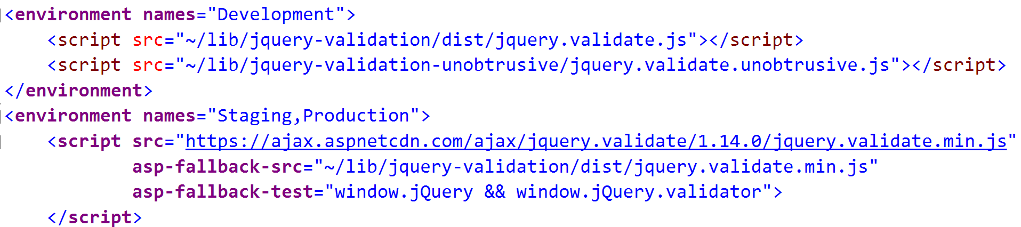
Range Attribute Rendered Output
Example: HTML rendered in View with jQuery unobtrusive validation attributes
Example: HTML rendered script references
<input class="text-box single-line" data-val="true" data-val-number="The field Rating must be a number." data-val-range="The field Rating must be between 1 and 5." data-val-range-max="5" data-val-range-min="1" data-val-required="The Rating field is required." id="Rating" name="Rating" type="number" value="" />
Notes:
jQuery unobtrusive validation is called “unobtrusive” because it leverages attributes on the HTML fields themselves instead of outputting inline JavaScript for validation as was done in MVC versions prior to MVC 3.
MVC 3 introduced support for jQuery Validation, whereas earlier versions relied on JavaScript libraries that Microsoft produced.
jQuery unobtrusive validation leverages jQuery at runtime to traverse the Document Object Model (DOM) and find the attributes used in validation.
All attributes that start with “data-val” are the attributes leveraged in validation.

Slide 11
Device Downgrade
Downgrade devices (Microsoft Internet Explorer 6, Mobile, etc.)
<script type="text/javascript">
//<![CDATA[
if (!window.mvcClientValidationMetadata) { window.mvcClientValidationMetadata = []; }
window.mvcClientValidationMetadata.push({"Fields":[{"FieldName":"GameName","ReplaceValidationMessageContents":true,"ValidationMessageId":"GameName_validationMessage","ValidationRules":[{"ErrorMessage":"Game Name must be a unique name!","ValidationParameters":{"url":"/Games/IsGameNameUnique","additionalfields":"*.GameName,*.GameId"},"ValidationType":"remote"}]},{"FieldName":"ReleaseDate","ReplaceValidationMessageContents":true});
//]]>
</script>
Notes:
If unobtrusive validation is disabled, but client validation is still enabled (from web.config), then the data necessary for jQuery validation is rendered in HTML, and the client-side is pushed to the jQuery validation engine (shown in slide).
If the device does not support JavaScript at all, the unobtrusive validation attributes are simply ignored, the form is submitted, and the server-side validation still occurs. If jQuery unobtrusive validation is enabled, and the device supports JavaScript, but not the advanced features necessary for jQuery unobtrusive validation, then this is determined by jQuery leveraging Modernizr which uses a combination of pre-determined browser UA mapping to feature capability along with real time capability detection, and in that case regular jQuery validation occurs instead of unobtrusive validation.
Instructor Note: Previously, in MVC 3 there was detection of user-agent, and if the device did not support unobtrusive validation, then the MicrosoftMvcValidation.js script reference and inline script was generated instead of unobtrusive validation. Although not explicitly called out in the MVC 4 release notes, in testing Internet Explorer 6 with UA Switcher in MVC 4, it appears this is no longer the case. Instead, the output is the same and downgrading is left to client-side Modernizr and jQuery validation library (cleaner).

Slide 12
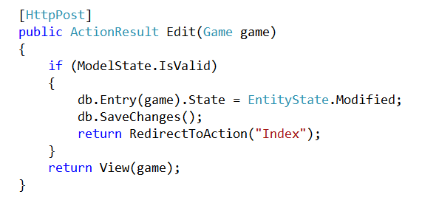
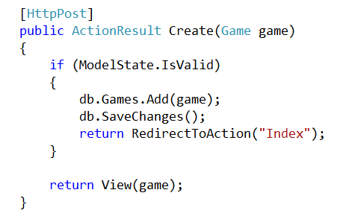
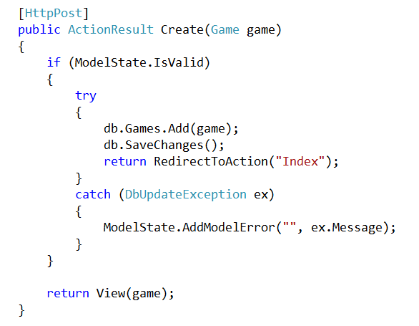
Data Annotations & ModelState
Notes:
In the Actions generated for Edit and Create, you will notice a property on “ModelState” IsValid.
When the ModelBinder attempts to bind the incoming data (which is passed in a ViewDataDictionary collection) to the model, any errors are appended to the Model Errors collection by the ModelBinder. Errors will be generated and added to the collection for any properties that have validation attributes that fail validation.
You can also manually add errors to the collection (as shown above). This may be appropriate for very simple applications, but as you cannot determine the field that generated the error and the exception message from a database update is typically not user friendly, it is preferred to have comprehensive validation attributes with customized ErrorMessages for each validation scenario.

Slide 13
Validation
ValidationMessage
ValidationSummary
@Html.ValidationMessageFor(model => model.Rating)
@Html.ValidationMessage("GameName", "some message")
@Html.ValidationSummary()
<span asp-validation-for=“Rating" class="text-danger"></span>
<div asp-validation-summary="ValidationSummary.All" class="text-danger"></div>
Notes:
The default Edit and Create views generated by the MVC 4 scaffolding leverages ValidationMessageFor which displays the resulting validation message.
The ValidationMessage HTML helper also renders a validation message if the specified field contains invalid input. If the DefaultModelBinder instance cannot bind a form-field value to the model, the binder adds an error to the ModelState object. When the view is rendered, the validation messages and validation summary are displayed based on the Errors property of the ModelState object. Both ValidationMessage and ValidationMessageFor can be overridden by adding an additional parameter for the error message.
ValidationSummary displays a summary of the error messages that do not correspond directly to a field, otherwise they are displayed inline in the ValidationMessage. This is controlled by the excludePropertyErrors parameter, which is true by default.

Slide 14
Remote Attribute
[Remote("IsGameNameUnique", "Games", AdditionalFields = "GameId", ErrorMessage = "Game Name must be a unique name!")]
public string GameName { get; set; }
public ActionResult IsGameNameUnique(string gameName, int? gameId)
{
var game = db.Games.FirstOrDefault(o => o.GameName == gameName);
if (game == null)
return Json(true, JsonRequestBehavior.AllowGet);
return Json(game.GameId == gameId, JsonRequestBehavior.AllowGet);
}
Notes:
The Remote Attribute was introduced in MVC 3 and it is helpful when you need to perform a server-side validation without submitting the entire form and without having to write the client-side AJAX code to handle the validation. This enables you to take advantage of the jQuery Validation plug-in's remote validator support; the client-side validation library automatically calls a custom method that you define on the server in order to perform validation logic that can only be done server-side. This occurs when focus lost event triggers the AJAX call, and the Action then returns a JavaScript Object Notation (JSON) formatted Boolean result indicating if the validation succeeded or not.
Note: For any ErrorMessage, you can specify the DisplayName inline, for example: ErrorMessage="Please supply a unique name for your {0}.“ Also, note that by default there is no space between words, so for example, GameName is not shown in the error message as “Game Name”. You can override the DisplayName property, and extend the built-in ModelMetadataProvider class to automatically include spaces for all camel cased properties.
The client side version of this class is ModelClientValidationRemoteRule. You can specify additional fields to be passed to the Action method using the “AdditionalFields” parameter by specifying the Model property to include.
Rarely used. People preferred to use via jquery libraries instead

Slide 15
Validation != Security
Include List
Bind against interface
Use ViewModel (Model-View-ViewModel (MVVM))
// include list
[HttpPost]
public ViewResult Edit([Bind(Include = "GameName")] Game game)
{
// ...
}
[HttpPost]
public ActionResult Create(Game game)
{
if (TryUpdateModel<IGameModel>(game))
{
[HttpPost]
public ActionResult Create(GameViewModel game)
{
Notes:
Validation does not protect against over and under posting attacks. These are four examples of methods to properly validate fields for binding purposes. Use one of these methods in addition to Validation when your model contains any properties that are vulnerable to over or under post attack.
Validation (server-side) ensures that the specified data in the fields posted do not break the validation rules defined, but they do not control which fields are supplied prior to binding. Over-posting example is easy to understand if you had an “IsAdmin” property not exposed in your model, or more common if you had a child property or collection on your model that could be unintentionally updated via EF (as is often the case with EF Navigation properties).
Under-posting can still occur with a “Required” data attribute if there is a default value specified in route rules or in the Model and the user removes that field from a faked HttpPost.
Use one of the methods that takes either a list of properties to include (a whitelist) or a list of properties to exclude (a blacklist). If no explicit whitelist or blacklist is passed, the TryUpdateModel method tries to update every public property in the model for which there is a corresponding value in the request. A malicious user could exploit this in order to update properties that you do not intend to provide access to.

Slide 16
Custom Attributes
Custom Attribute with Client-Side Validation
public class UrlValidAttribute : ValidationAttribute, IClientValidatable
{
public override bool IsValid(object value)
{
if (value == null || ((string)value).ToLowerInvariant().Contains("microsoft"))
return false;
return true;
}
public IEnumerable<ModelClientValidationRule>
GetClientValidationRules(ModelMetadata metadata, ControllerContext context)
{
yield return new ModelClientValidationRule
{
ErrorMessage = this.ErrorMessage,
ValidationType = "urlvalid"
};
}
}
Notes:
The attribute is declared on the server-side model property. Metadata can be associated with an existing class without modifying the actual underlying Model.
Note: The jQuery validation calls adapter “urlvalid”, which must be added.

Slide 17
Custom Validation
Custom Client-Side Validation - In Views
@section Scripts { @Scripts.Render("~/bundles/jqueryval") <script type="text/javascript"> // -- jQuery validation method jQuery.validator.addMethod('urlvalidCheck', function (value, element, params) { return (!/microsoft/.test(value)); }, ''); // add the unobtrusive adapter jQuery.validator.unobtrusive.adapters.add('urlvalid', {}, function (options) { options.rules['urlvalidCheck'] = true; options.messages['urlvalidCheck'] = options.message; }); </script> }
Notes:
The attribute is declared on the server-side model property. Metadata can be associated with an existing class without modifying the actual underlying Model. Note the addition of a new jQuery validation method. Note that the string to search for (“microsoft”) in this example is embedded in the view’s code. It could easily be passed into the client side method as a property and defined as a parameter to your custom data annotation instead so that future changes would be made in the server-side annotation instead of in the view’s code, just as ErrorMessage is done.

Slide 18
Client-side Validation
Built-in jQuery validation methods
Validation Method | Description
minlength( length ) Returns: Boolean | Makes the element require a given minimum length
maxlength( length ) Returns: Boolean | Makes the element require a given maximum length
min( value ) Returns: Boolean | Makes the element require a given minimum
max( value ) Returns: Boolean | Makes the element require a given maximum
email( ) Returns: Boolean | Makes the element require a valid email
url( ) Returns: Boolean | Makes the element require a valid URL
dateISO( ) Returns: Boolean | Makes the element require a ISO date
number( ) Returns: Boolean | Makes the element require a decimal number
digits( ) Returns: Boolean | Makes the element require digits only
creditcard( ) Returns: Boolean | Makes the element require a creditcard number
accept( extension ) Returns: Boolean | Makes the element require a certain file extension
equalTo( other ) Returns: Boolean | Is Equal To
Notes:
There are a number of built-in validation methods in jQuery. The validation methods shown in the table on the slide region are not directly associated with an existing Data Annotation (for example, Required, Range, etc.). Leveraging the existing jQuery validation rules means you do not have to write client-side code.

Slide 19
DataType Attribute
Use DataType Attribute to leverage the existing jQuery validators, or add them to custom client validation rules by name
[DataType(DataType.CreditCard)]
public string CreditCard { get; set; }
[DataType(DataType.EmailAddress)]
public string Email { get; set; }
[DataType(DataType.Url)]
public string Url { get; set; }

Slide 20
Handling Validation Errors in Web API
Web API does not automatically return an error to the client when validation fails
Use the controller action to check for model state, and respond appropriately through HTTP.
[HttpPost]
public void CreateTodoItem([FromBody] TodoItem item)
{
if (!ModelState.IsValid)
{
HttpContext.Response.StatusCode = 400;
}
}

Slide 21
Demo: Validation
Notes:
Demo Script:
We will be using the Account Registration page for demoing ASP.NET Core validation.
Open ValidationDemo solution in the Demos folder. The modified version has all the data annotation commented out for the RegisterViewModel. The Register.cshtml also has the reference to _validationScriptsPartial commented.
In the Register.cshtml, talk about the tag helper asp-validation-for used to display a validation message for a property from the model.
Run the application and navigate to the Register page (top right from the home page).
Right-click and view source. Show the generated <span> because of the tag helper: <span class="text-danger field-validation-valid" data-valmsg-for="Email" data-valmsg-replace="true"></span>
There is no validation implemented yet. Open the RegisterViewModel and uncomment the [Require] attribute for the email property.
Run the application, navigate to the Registration page again and show the newly generated HTML attributes: data-val="true" data-val-required="The Email field is required."
Close the ViewSource popup, and click the Register button. The error message will be displayed, but notice the postback. We just implemented server validation.
Put a break point in the AccountController.cs, Register action method and the line: if (ModelState.IsValid)
Click the Register button again, the application break at the line and show the value of IsValid. Comment about the ModelState object.
For client validation, go to the Register.cshtml and uncomment the Scripts section. Show the _ValidationScriptsPartial.cshtml partial view:
jQuery validation libraries are used for client validation
Comment on the CDN reference of the libraries and also the fallback mechanism thanks to asp-fallback taghelpers
Run the application again and navigate to the Registration page. Click the Register button and now there is no server postback.
Go back to the RegisterViewModel. Comment about attribute and data annotation. Show the different parameters for the Require attribute or any others.
Validation demo is complete.

Slide 22
Module 7: Validation
Section 2: Don’t Repeat Yourself Principle
Lesson: Example Scenario

Slide 23
Don’t Repeat Yourself!
Notes:
One of the core design tenets of ASP.NET MVC is DRY- Don’t Repeat Yourself”. ASP.NET MVC encourages you to specify functionality or behavior only once, and then have it be reflected everywhere in an application. This reduces the amount of code you need to write and makes the code you write less error prone, easier to test, and easier to maintain.
The validation support provided by ASP.NET MVC and Entity Framework Code First is a great example of the DRY principle in action. You can declaratively specify validation rules in one place (in the model class) and the rules are enforced everywhere in the application.
Let us look at how you can take advantage of this validation support in the movie application.

Slide 24
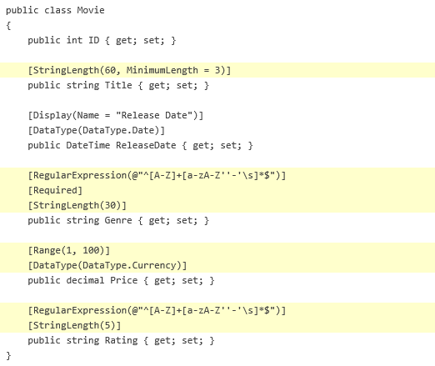
1. Define a Model
Movie Model
Notes:
The validation attributes specify behavior that you want to enforce on the model properties they are applied to. The Required and MinimumLength attributes indicates that a property must have a value; but nothing prevents a user from entering white space to satisfy this validation.
The RegularExpression attribute is used to limit what characters can be input. In the code above, Genre and Rating must use only letters (white space, numbers and special characters are not allowed).
The Range attribute constrains a value to within a specified range. The StringLength attribute lets you set the maximum length of a string property, and optionally its minimum length. Value types (such as decimal, int, float, DateTime) are inherently required and don not need the [Required] attribute.

Slide 25
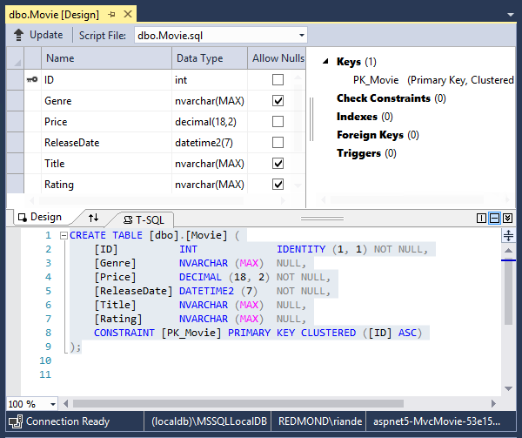
2. Generated DB Schema
Notes:
The image on the slide region shows the table design and the Transact-SQL that can generate the table.

Slide 26
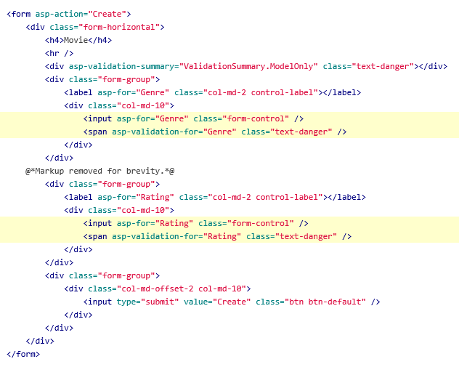
3. Scaffolded Views with Validation
Notes:
It is a portion of the Create.cshtml view template that was scaffolded. It is used by the action methods both to display the initial form and to redisplay it in the event of an error.

Slide 27
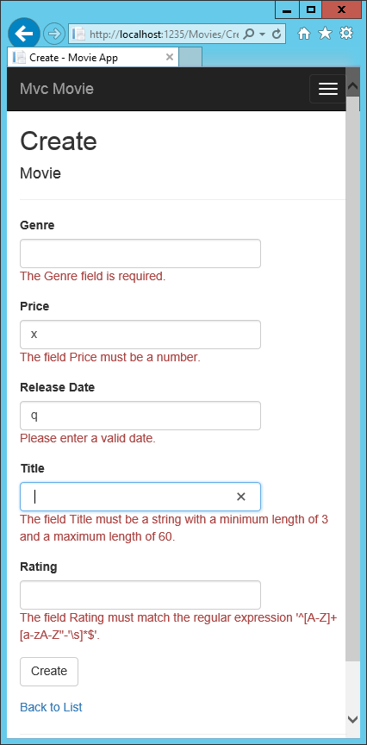
4. Validation Messages on UI
Notes:
Notice how the form has automatically rendered an appropriate validation error message in each field containing an invalid value. The errors are enforced both client-side (using JavaScript and jQuery) and server-side (in case a user has JavaScript disabled).
A significant benefit is that you do not need to change a single line of code in the MoviesController class or in the Create.cshtml view in order to enable this validation UI. The controller and views you created earlier in this tutorial automatically picked up the validation rules that you specified by using validation attributes on the properties of the Movie model class. Test validation using the Edit action method, and the same validation is applied.

Slide 28

Module Summary
In this module, you learned about:
Validation
Data Annotations
Client-Side and Server Side Validation
Validation != Security

Slide 29
Lab: Validation in ASP.NET MVC

Slide 30


